Slide 1


Amazon ECS Workshop
2miles
AWS

Slide 2


Introduction
2miles

Slide 3
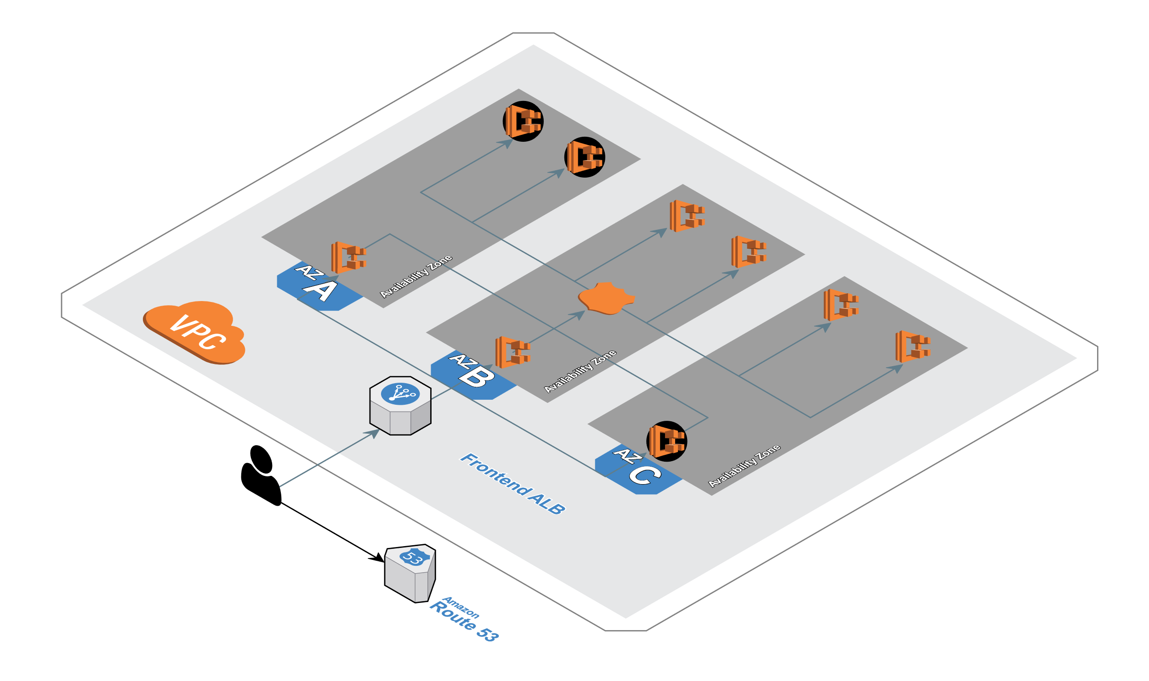
Three Tier Architecture
We will learn by doing and will build a typical 3 tier polyglot microservice stack like you may work with in your organization.

Slide 4
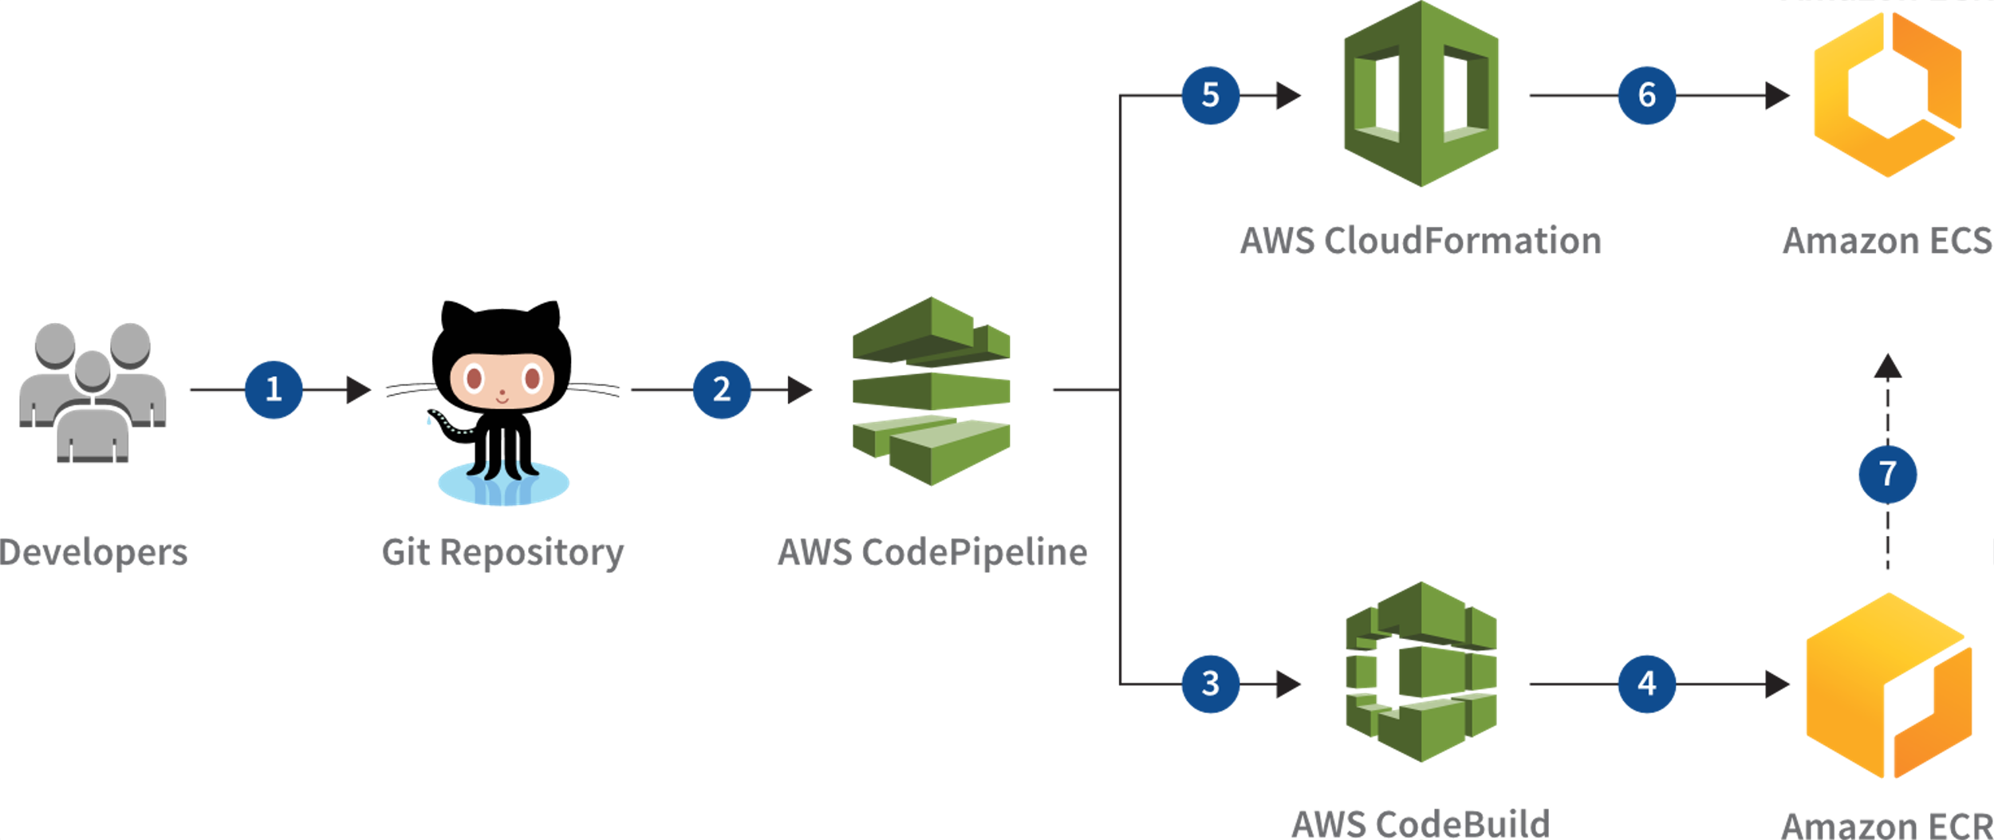
CI/CD Pipeline
We will build out a typical devops CI/CD pipeline using best practices, and will Continuously Deliver code updates to an acceptance environment, with manual promotion to the production environment.

Slide 5
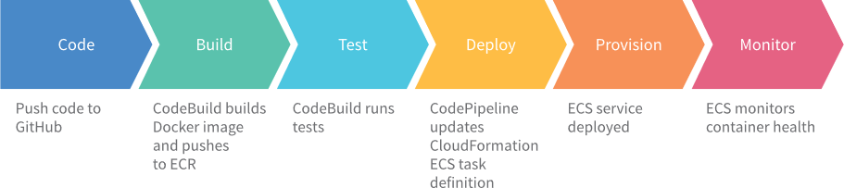
Structure
Our structure will be: 1 repo -> 1 pipeline -> 1 container -> 1 service

Slide 6
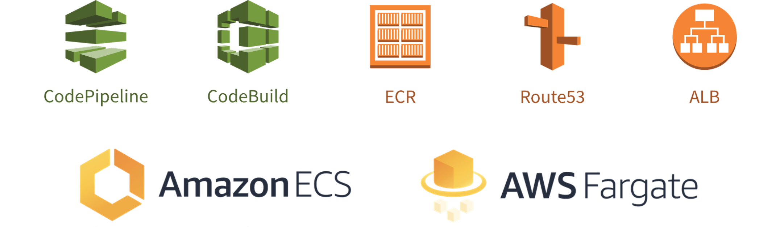
AWS Services
We will use many AWS services, including CodePipeline, CodeBuild, ECS, ECR, Fargate, Route53 and ALB.

Slide 7


Why ECS?
Amazon Elastic Container Service (Amazon ECS) is a highly scalable, high-performance container orchestration service that supports Docker containers and allows you to easily run and scale containerized applications on AWS.
Amazon ECS eliminates the need for you to install and operate your own container orchestration software,
manage and scale a cluster of virtual machines, or schedule containers on those virtual machines.
ECS is also deeply integrated into the rest of the AWS ecosystem.

Slide 8

Why Fargate?
AWS Fargate is a technology for Amazon ECS that allows you to run containers without having to manage servers or clusters. With AWS Fargate, you no longer have to provision, configure, and scale clusters of virtual machines to run containers. This removes the need to choose server types, decide when to scale your clusters, or optimize cluster packing.
AWS Fargate removes the need for you to interact with or think about servers or clusters. Fargate lets you focus on designing and building your applications instead of managing the infrastructure that runs them.

Slide 9
Prerequisites
2miles

Slide 10
Create an AWS account
1. If you don’t already have an AWS account with Administrator access: create one now
2. Once you have an AWS account, ensure you are following the remaining workshop steps as an IAM user with administrator access to the AWS account: Create a new IAM user to use for the workshop
3. Enter the user details:

Slide 11
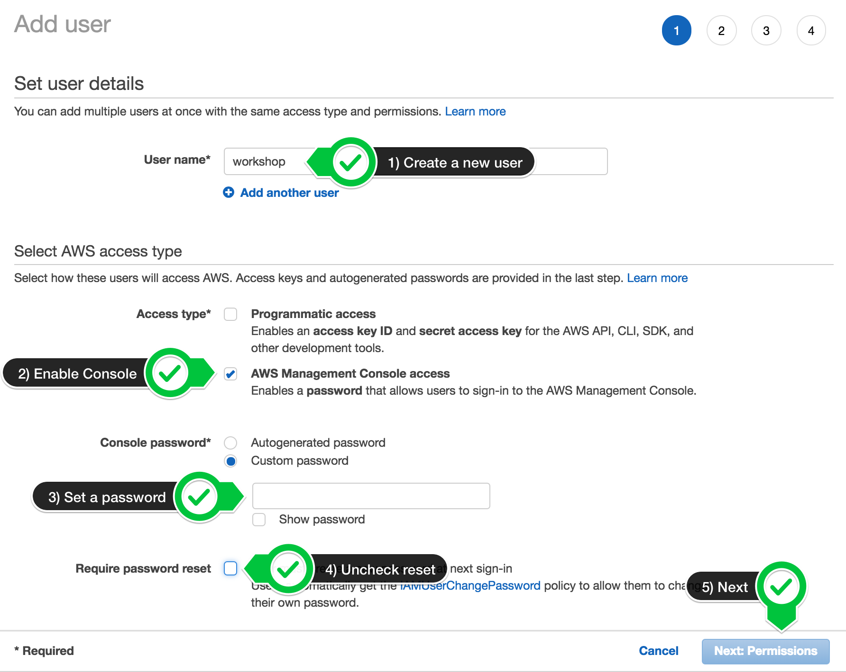
Create an AWS account

Slide 12
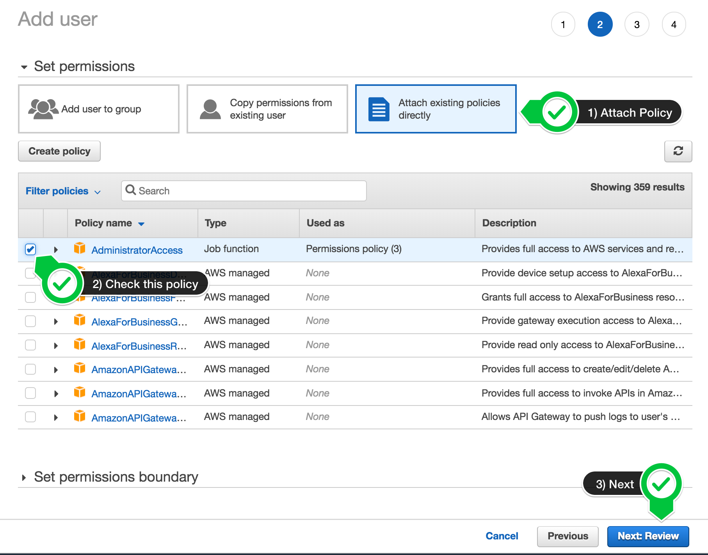
Create an AWS account
4. Attach the AdministratorAccess IAM Policy:

Slide 13
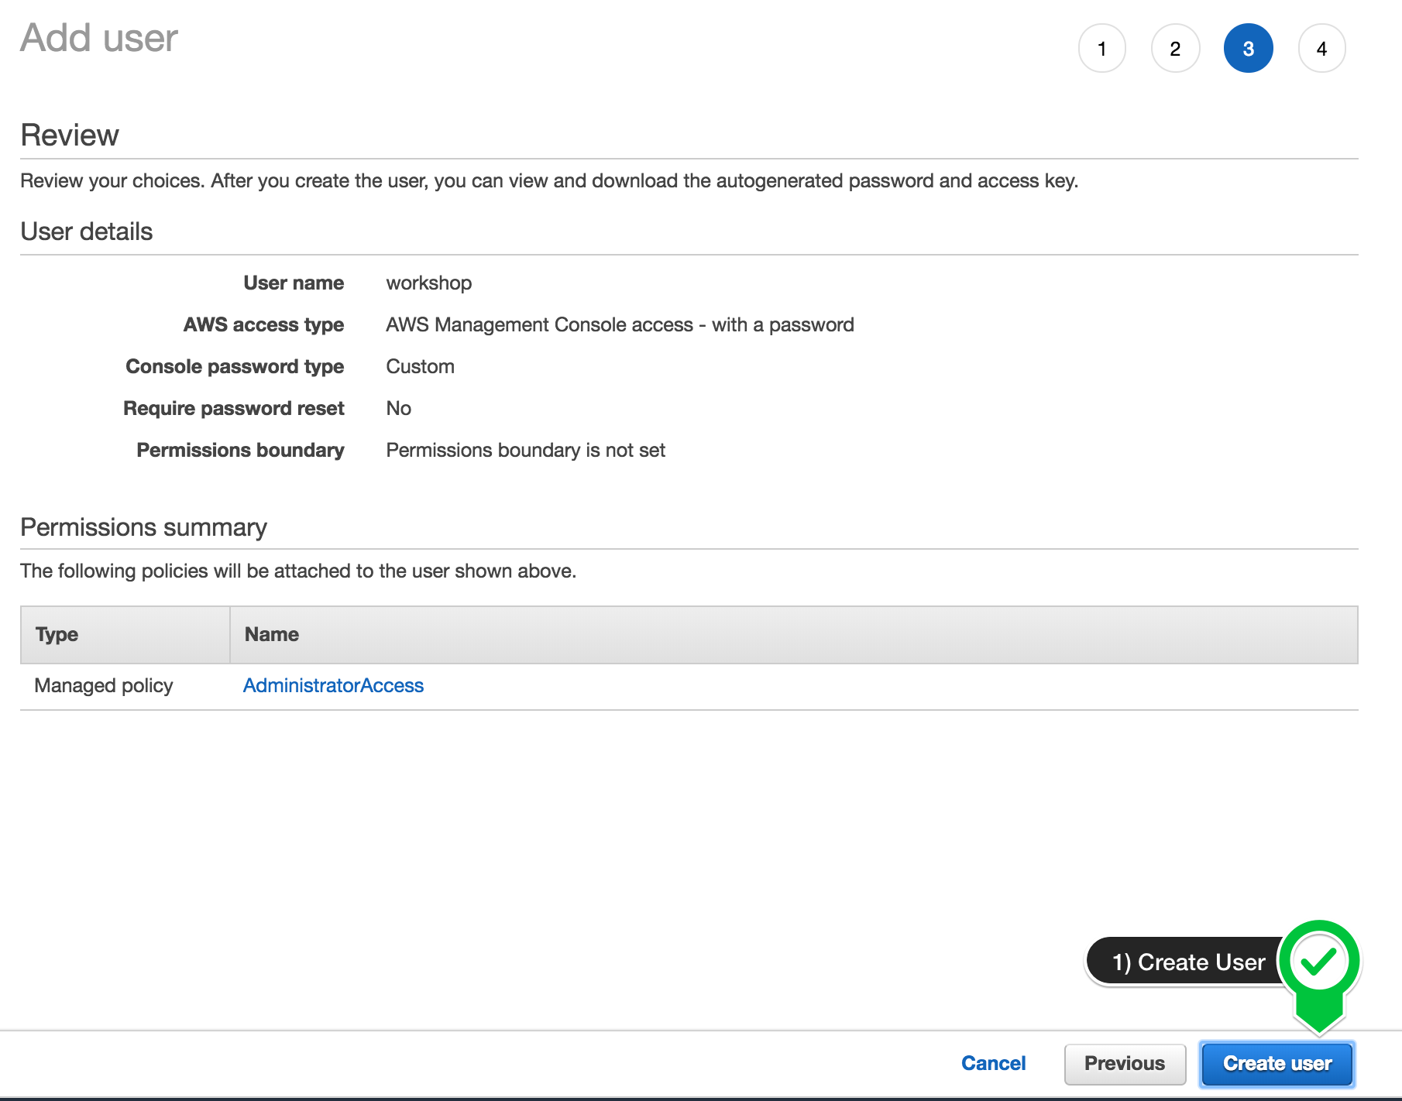
Create an AWS account
5. Click to create the new user:

Slide 14
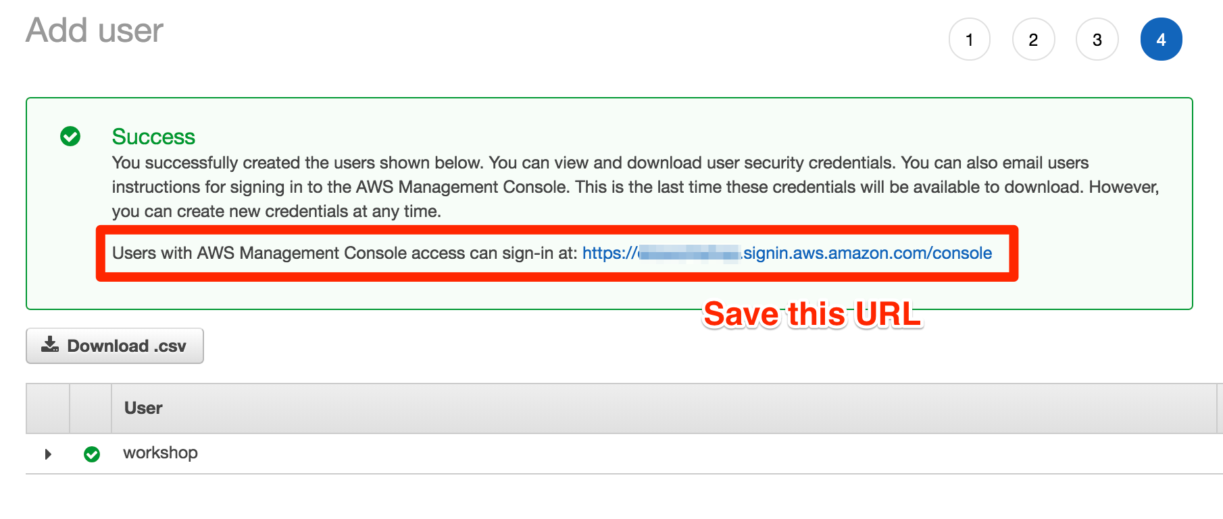
Create an AWS account
6. Take note of the login URL and save:

Slide 15
Create a Workspace
Create a Cloud9 Environment
select Create environment
Name it workshop, and take all other defaults
When it comes up, customize the environment by closing the welcome tab and lower work area, and opening a new terminal tab in the main work area:

Slide 16
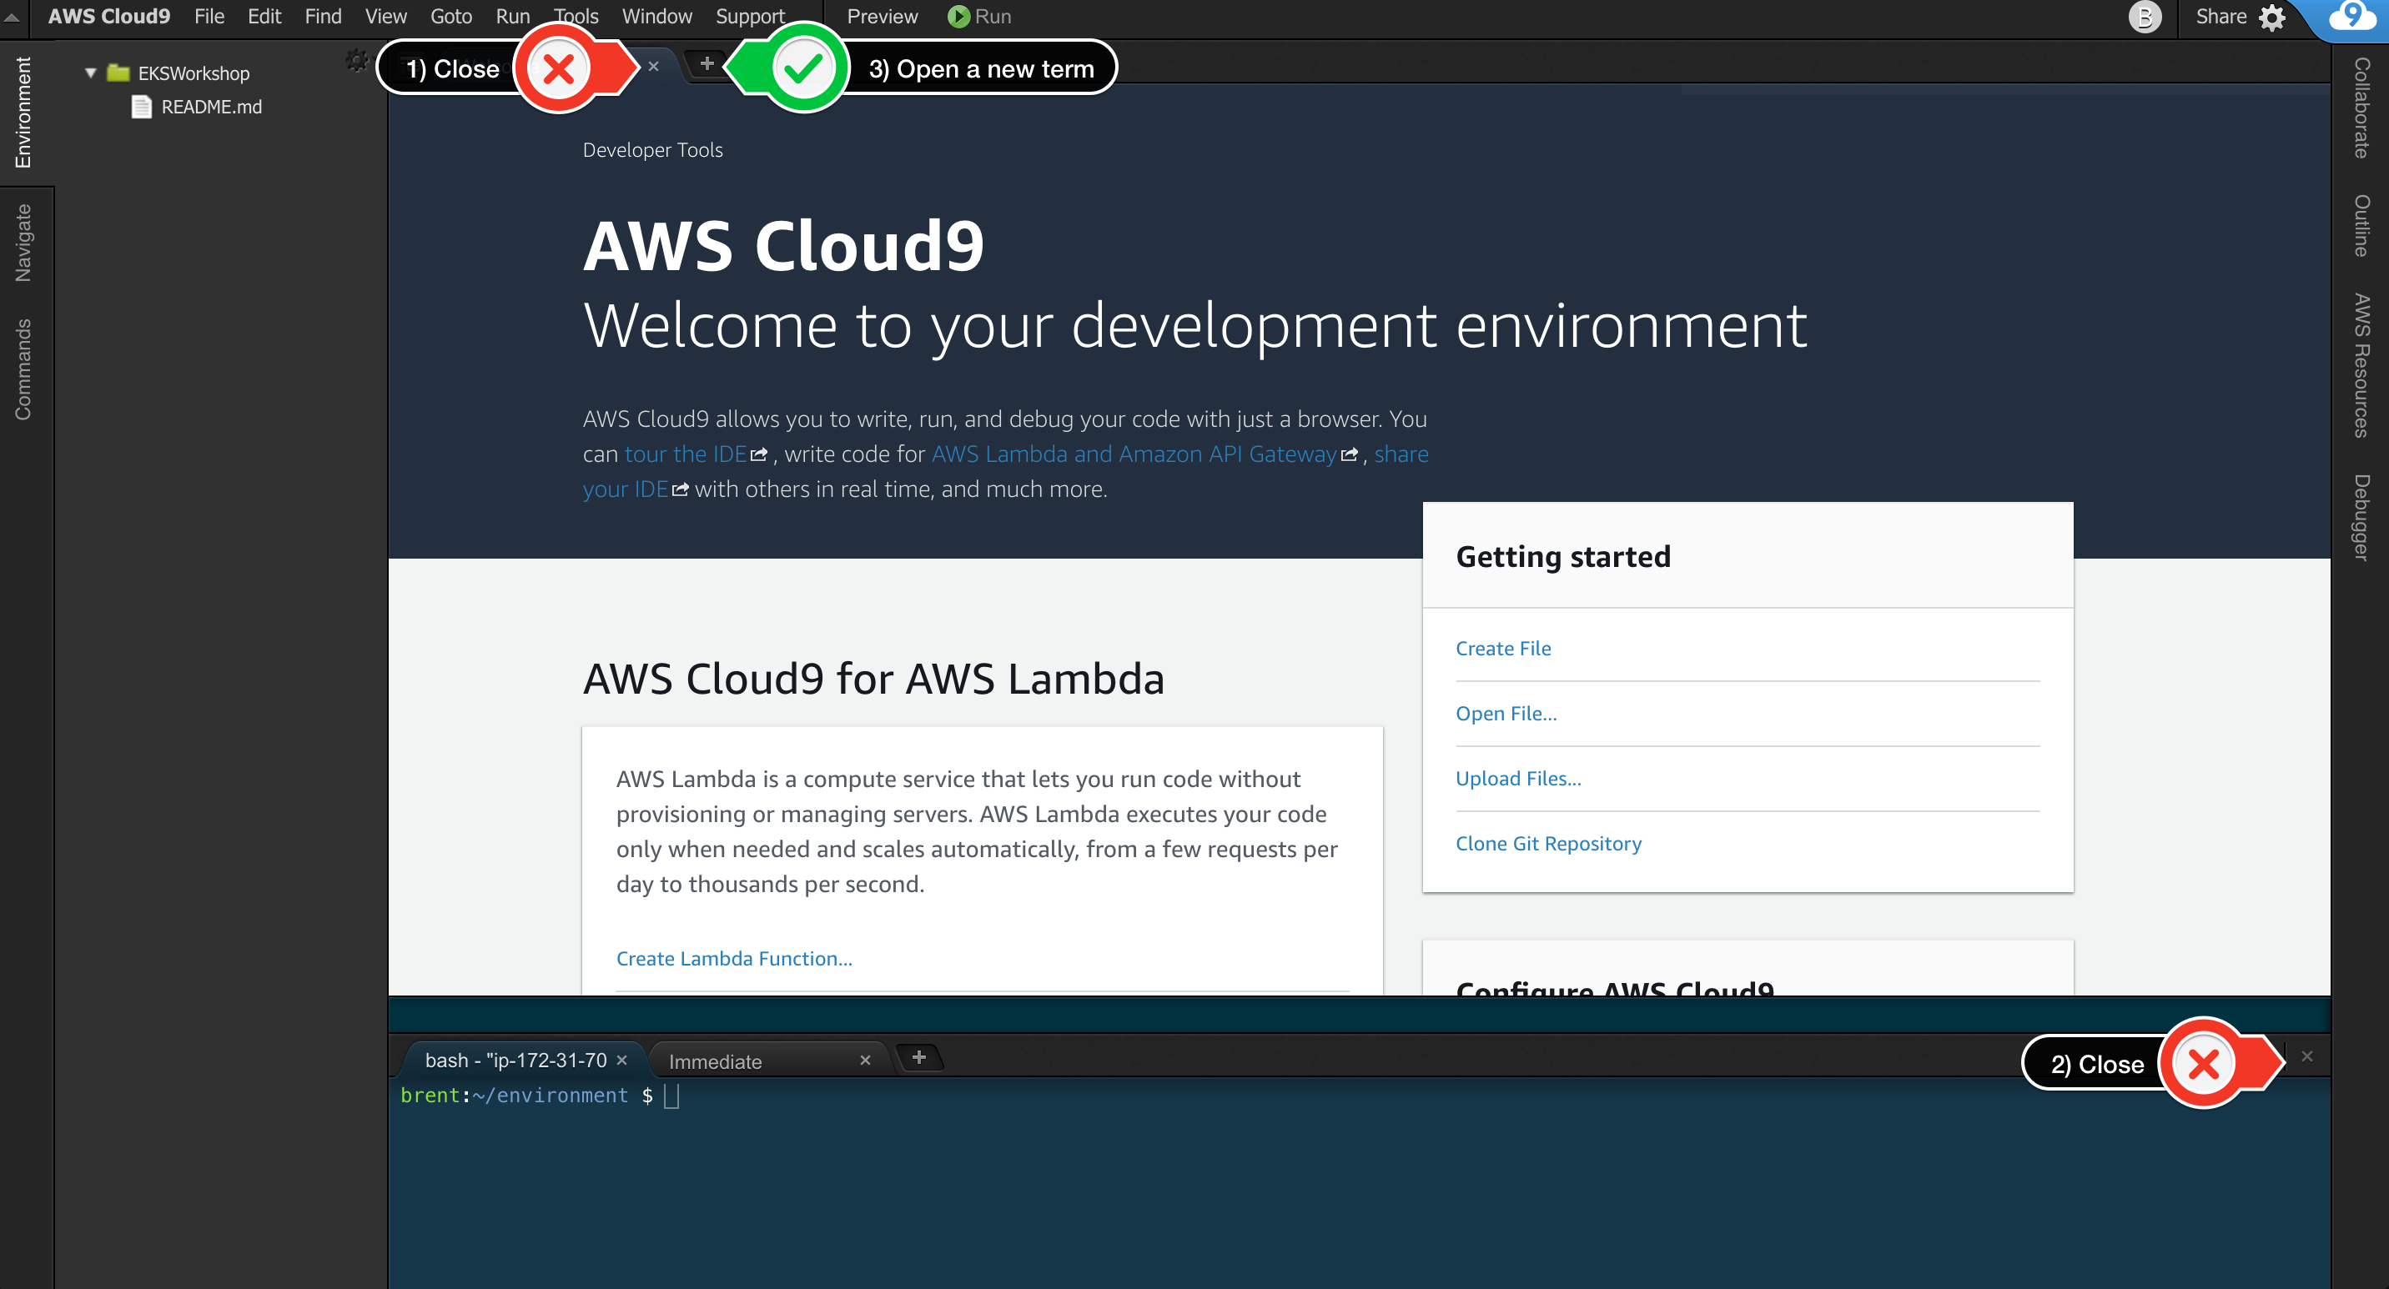
Create a Workspace
Your workspace should now look like this:

Slide 17
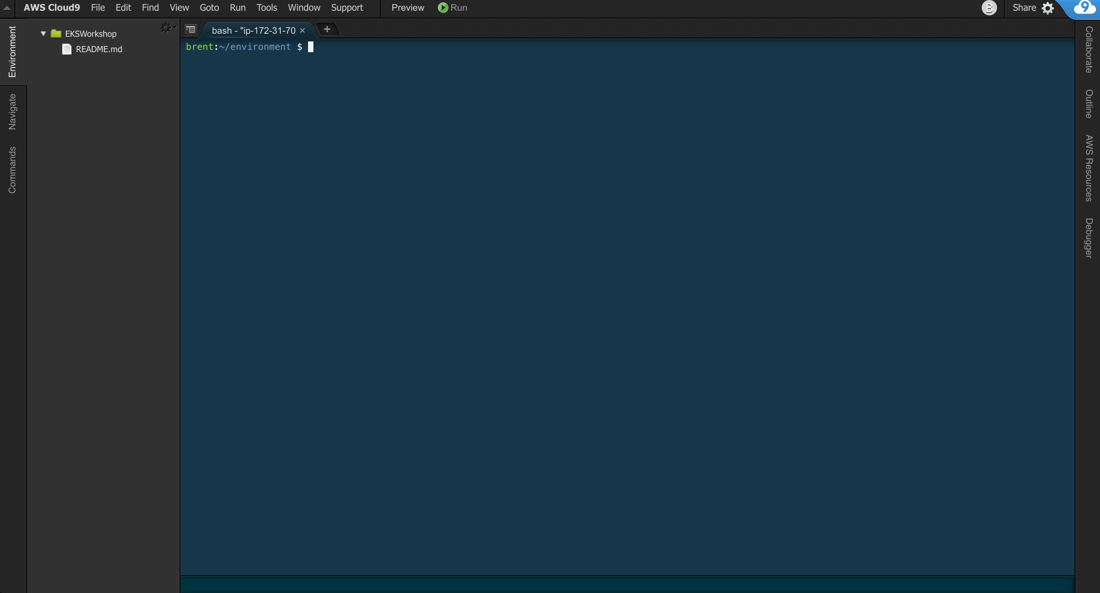
Create a Workspace
If you like this theme, you can choose it yourself by selecting View / Themes / Solarized / Solarized Dark in the Cloud9 workspace menu.

Slide 18
Install and Configure Tools
In the Cloud9 workspace, run the following commands:
First install the ECS cli (plus some other text utilities):
sudo curl -so /usr/local/bin/ecs-cli https://s3.amazonaws.com/amazon-ecs-cli/ecs-cli-linux-amd64-latest
sudo chmod +x /usr/local/bin/ecs-cli
sudo yum -y install jq gettext
Next configure the AWS cli with our current region as default:
export AWS_REGION=$(curl -s 169.254.169.254/latest/dynamic/instance-identity/document | jq -r .region)
echo "export AWS_REGION=${AWS_REGION}" >> ~/.bash_profile
aws configure set default.region ${AWS_REGION}
aws configure get default.region

Slide 19
Install and Configure Tools
In the Cloud9 workspace, run the following commands:
curl -s https://getmu.io/install.sh | sudo sh
We should set a namespace so that multiple IAM users can run this workshop in the same AWS account.
We will pick a random two character string and save it to our environment:
export MU_NAMESPACE="mu-$(uuidgen -r | cut -c1-2)"
echo "export MU_NAMESPACE=$MU_NAMESPACE" >> ~/.bashrc
echo "My namespace is $MU_NAMESPACE"

Slide 20
Create a SSH key
1. Create a ssh key and add it to your GitHub account.
ssh-keygen
2. Copy the public key to your clipboard
cat ~/.ssh/id_rsa.pub
3. Go to https://github.com/settings/ssh/new and paste your key in the box marked key
4. Type workshop in the title, and select Add SSH key
- You should be prompted to confirm your password

Slide 21
Create a GitHub token
Go to https://github.com/settings/tokens/new Type workshop in the token description
Check repo
Check admin:repo_hook
Select generate token
Let’s add your GitHub token to the environment:
export GITHUB_TOKEN=your_github_token
Once that is set correctly, we will persist it for future terminals:
echo "export GITHUB_TOKEN=${GITHUB_TOKEN}" >> ~/.bashrc

Slide 22
Fork the GitHub Repos
Fork these GitHub repos to your own GitHub account:
https://github.com/brentley/ecsdemo-platform/fork
https://github.com/brentley/ecsdemo-frontend/fork
https://github.com/brentley/ecsdemo-nodejs/fork
https://github.com/brentley/ecsdemo-crystal/fork

Slide 23
Clone your Repos
Clone your forked repos to your workspace:
export YOUR_GITHUB_NAME=your_username
cd ~/environment
git clone git@github.com:$YOUR_GITHUB_NAME/ecsdemo-platform.git
confirm the github key fingerprint
git clone git@github.com:$YOUR_GITHUB_NAME/ecsdemo-frontend.git
git clone git@github.com:$YOUR_GITHUB_NAME/ecsdemo-nodejs.git
git clone git@github.com:$YOUR_GITHUB_NAME/ecsdemo-crystal.git

Slide 24
Platform
2miles

Slide 25
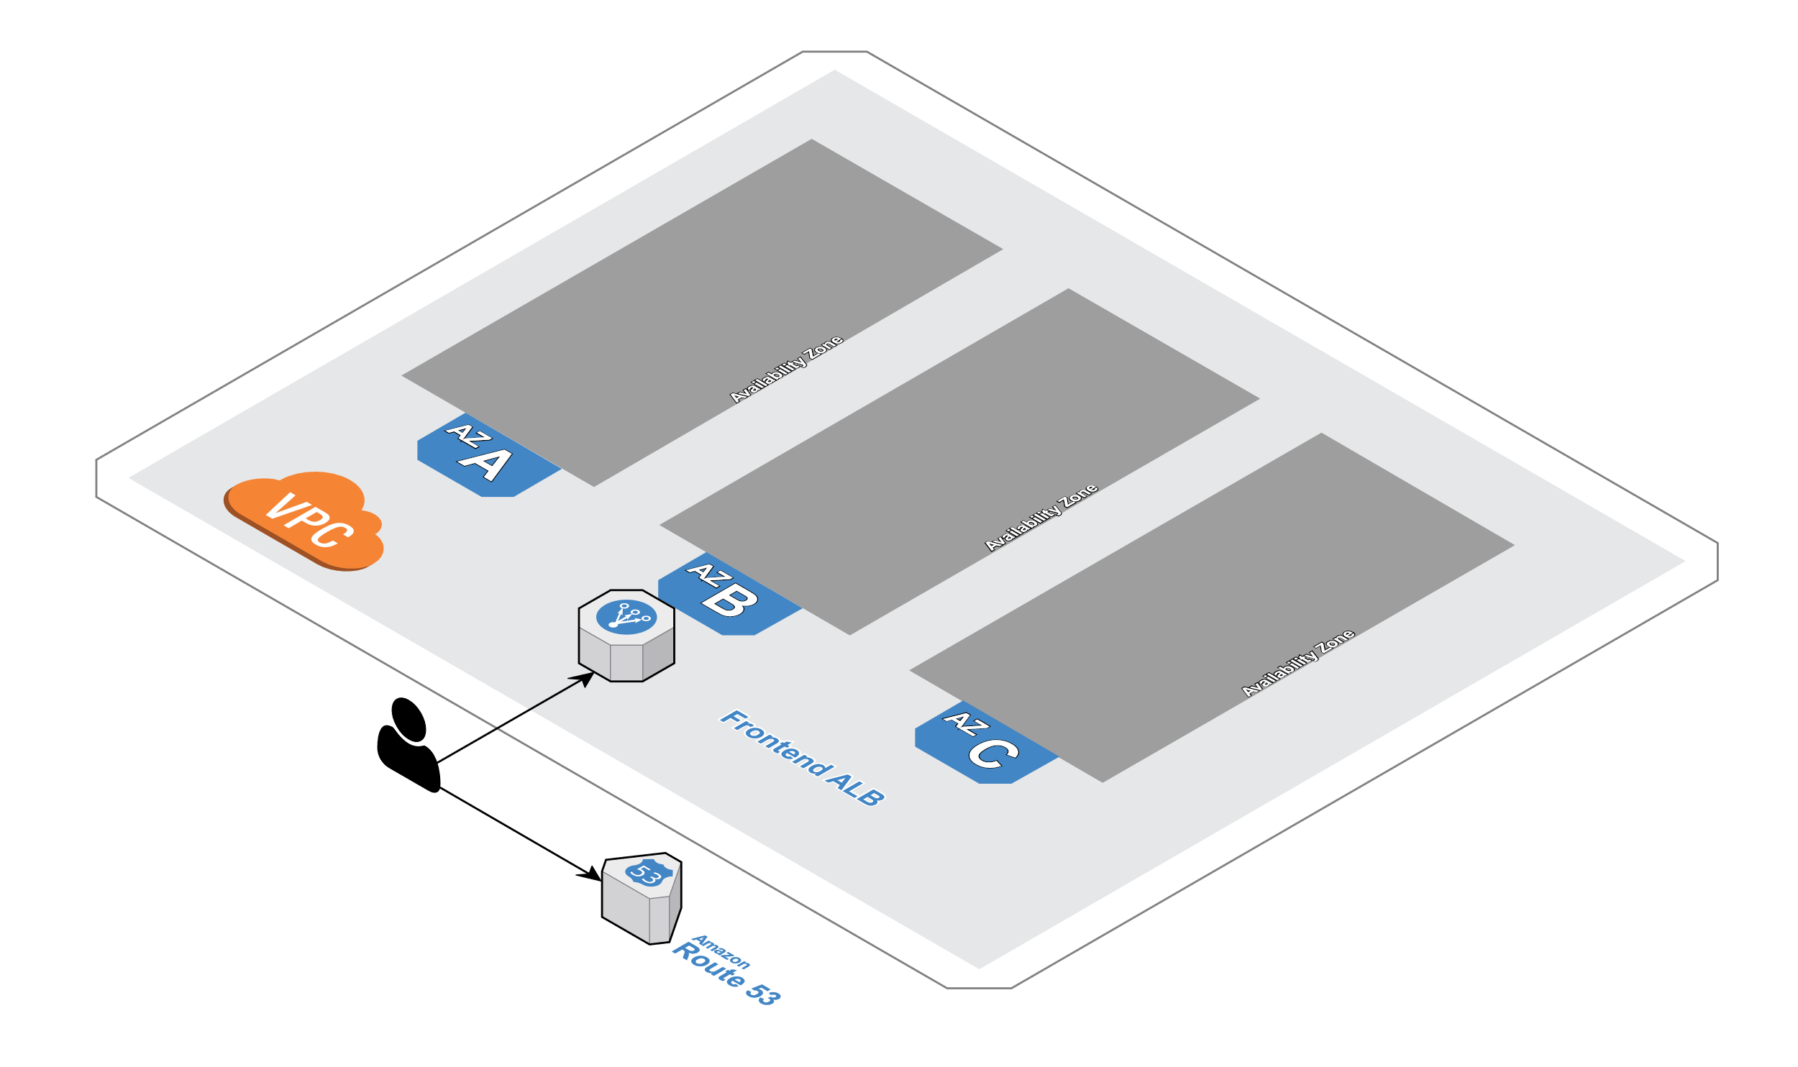
Build the Platform

Slide 26
Build the Platform
If breaking down a monolith into microservices is a good idea, then it stands to reason that keeping the code that manages your app platform small and simple also makes sense.
In this workshop, we manage the infrastructure with this repository, and then each service will be maintained in it’s own separate repository.
This repository will generate CloudFormation Stacks that will build 2 independent environments called Acceptance and Production.

Slide 27
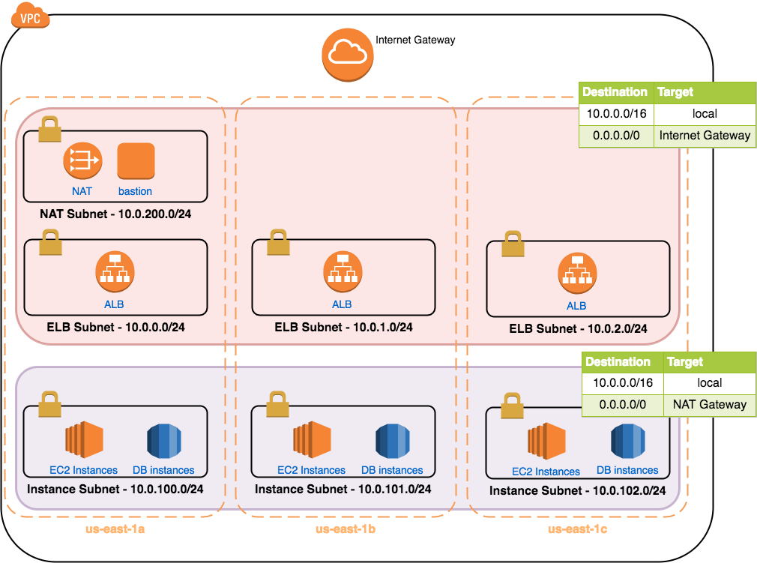
Build the Platform

Slide 28

Mu
We will use Mu for this workshop. Why Mu?
It’s Opinionated
Mu takes all of the best practices learned from operating in many organizations and generates sensible boilerplate CloudFormation to support running your infrastructure and microservices.
It focuses on the developer experience
Mu keeps the developer experience simple, giving tools to get your microservice running as quickly as possible, and tools to support the developer troubleshooting problems with the microservices.
It’s Cloud Native
Mu knows when to stay out of the way. Mu only uses AWS resources for deploying your microservices.
Continuous Delivery
Mu uses CodePipeline and CodeBuild to continuously test and delivery your microservice to production.

Slide 29
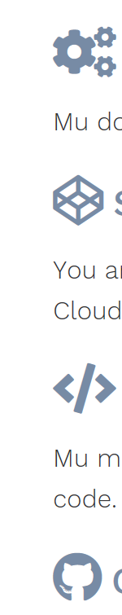
Mu
We will use Mu for this workshop. Why Mu?
Polyglot
Mu doesn’t have a favorite language. If you can get your microservice running with a Dockerfile, then mu can help!
Stateless
You are not locked in to using Mu. Mu doesn’t have any servers or databases running anywhere. Mu leverages CloudFormation to manage state for all AWS resources.
Declarative
Mu makes sure you get what you want. You declare your configuration in a YAML file and commit with your source code. Mu takes care of setting up your AWS resources to meet your needs.
Open Source
Mu is MIT licensed, so you can use it commercially. Mu is always looking to improve, so please consider contributing!

Slide 30
Example
To build both the Acceptance and Production platforms, the only code we maintain ourselves is found in mu.yml
---
environments:
- name: acceptance
provider: ecs-fargate
name: production
provider: ecs-fargate
service:
acceptance:
disabled: true
production:
disabled: true
In this file, we define that we want two environments, each using Amazon ECS and AWS Fargate for ECS. We disable any service deploys, since this repo is only used to build and maintain infrastructure.
Because we’re using Mu and it’s built-in best practice defaults, the amount of code we have to maintain remains simple.

Slide 31
Build the Environments
사용자별 클러스터명을 변수로 설정
export fargate_name=fargate-demo-user17
export fargate_alb_name=fargate-demo-alb-user17

Slide 32
Build the Environments
In the Cloud9 workspace, run the following commands:
Clone the demo repository:
export YOUR_GITHUB_NAME=your_username
git clone https://github.com/brentley/fargate-demo.git
Ensure service linked roles exist for Load Balancers and ECS:
aws iam get-role --role-name "AWSServiceRoleForElasticLoadBalancing" || aws iam create-service-linked-role --aws-service-name "elasticloadbalancing.amazonaws.com" aws iam get-role --role-name "AWSServiceRoleForECS" || aws iam create-service-linked-role --aws-service-name "ecs.amazonaws.com"
Build a VPC, ECS Cluster, and ALB:
cd ~/environment/fargate-demo
aws cloudformation deploy --stack-name $fargate_name --template-file cluster-fargate-private-vpc.yml --capabilities CAPABILITY_IAM
aws cloudformation deploy --stack-name $fargate_alb_name --template-file alb-external.yml
cluster-fargate-private-vpc.yml 파일에서 “Default=fargatedemo”를 “Default=fargatedemo-user**”로 수정
alb-external.yml 파일도 동일하게 “Default=fargatedemo”를 “Default=fargatedemo-user**”로 수정

Slide 33
Frontend Rails App
2miles

Slide 34
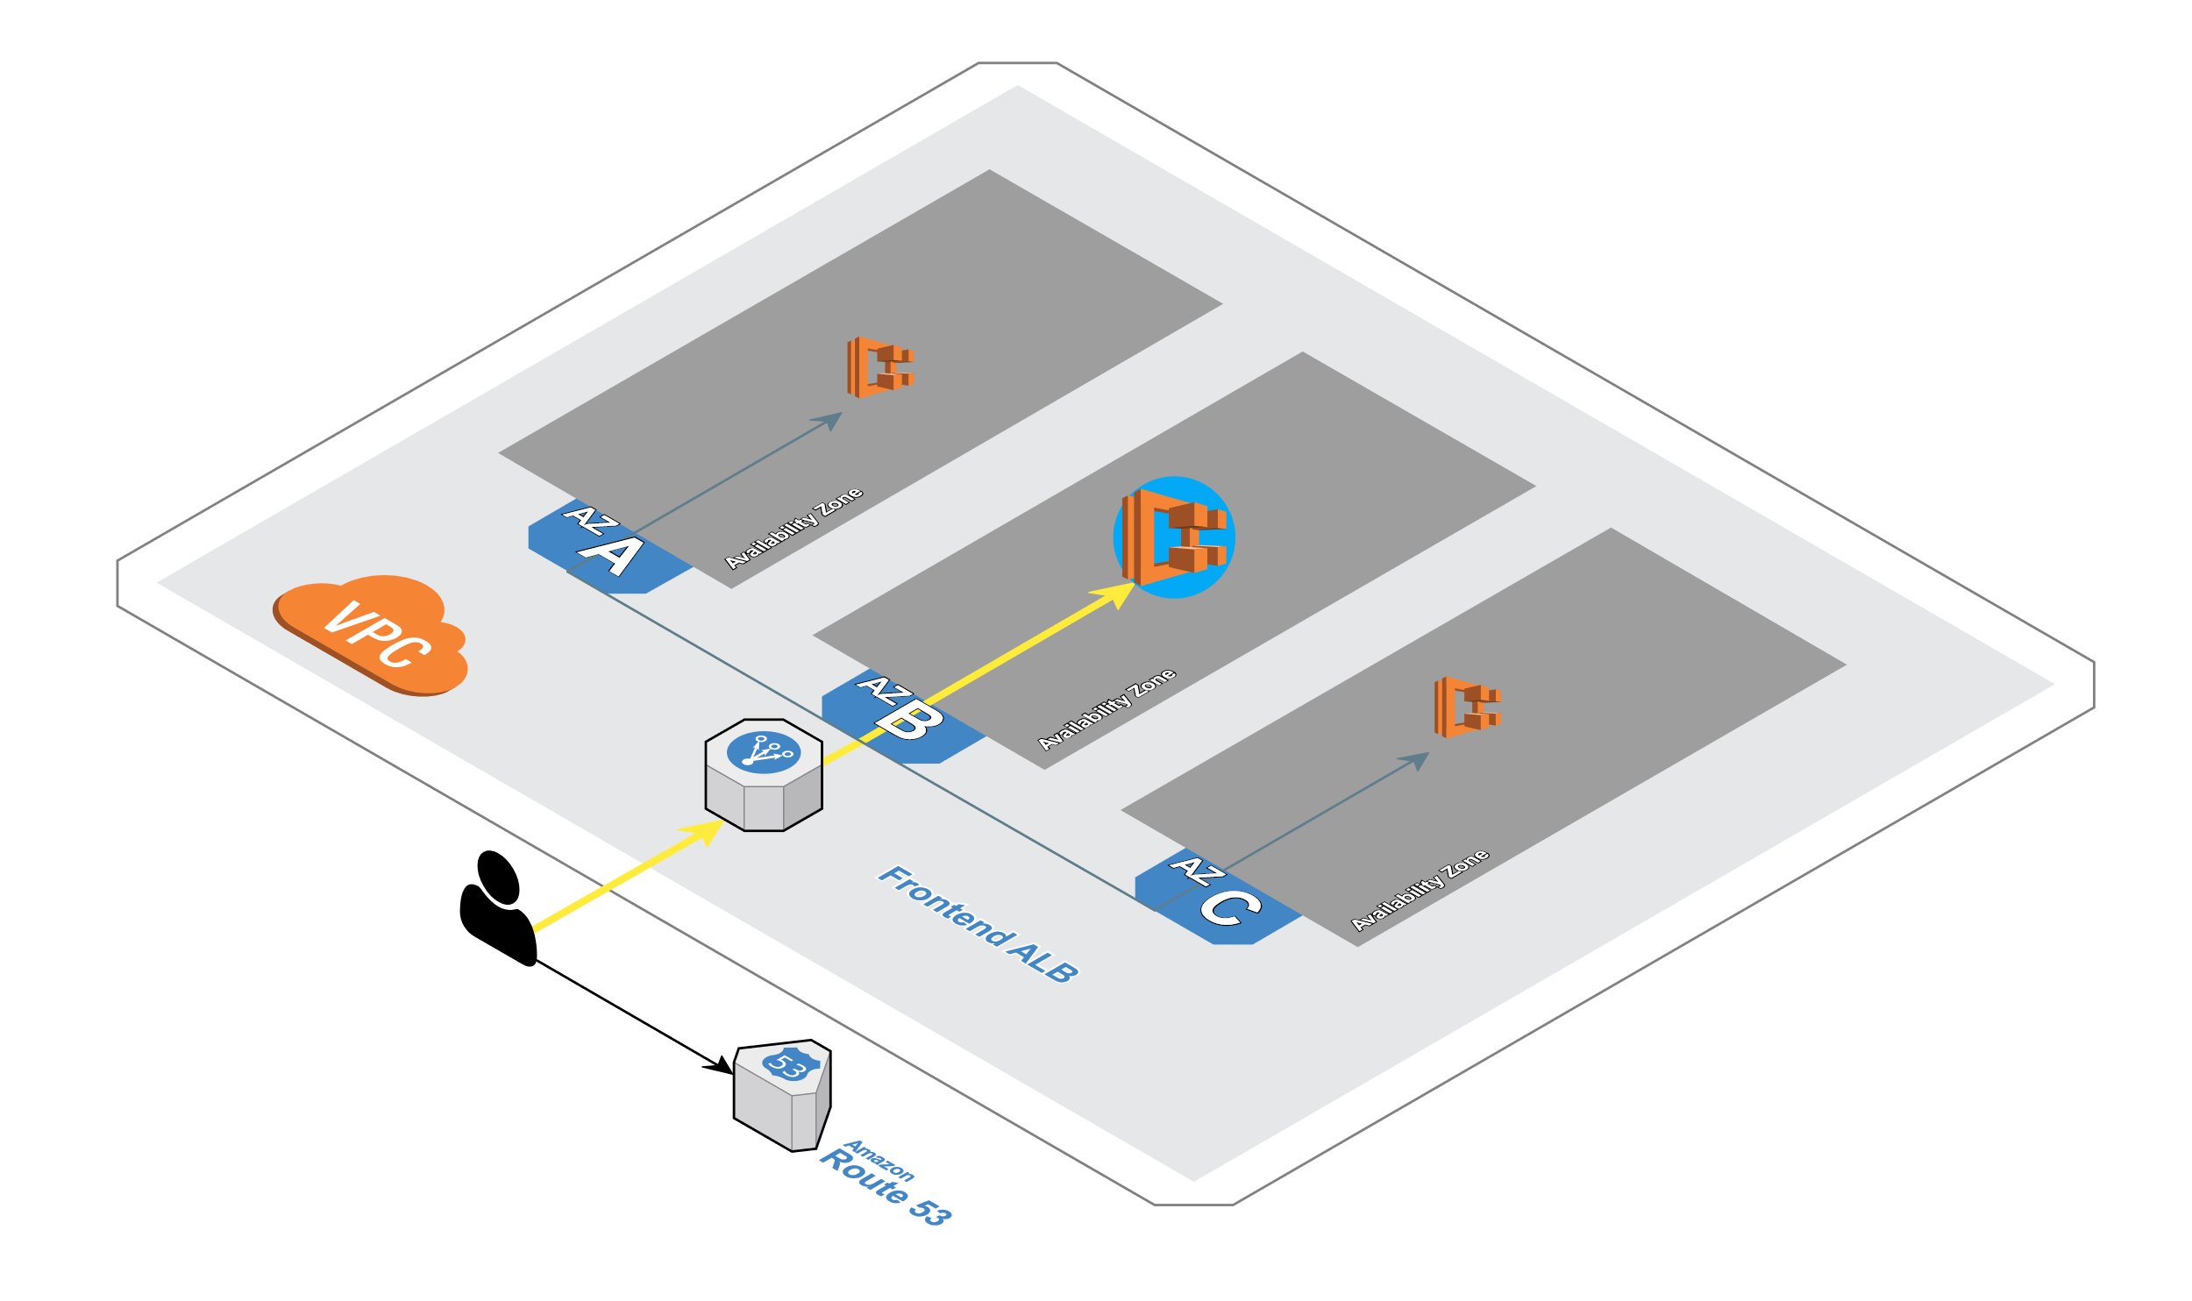
Frontend Rails App

Slide 35
Frontend Service
Again, we can take advantage of opinionated tooling to deploy our service using best practices.
When a service team wants to build a new service, they can include their own mu.yml and inherit best practices such as blue/green deploys, healthchecks, and autoscaling for their service.
---
service:
desiredCount: 3
maxSize: 6
port: 3000
pathPatterns:
- /*
networkMode: awsvpc
environment:
CRYSTAL_URL: "http://ecsdemo-crystal/crystal"
NODEJS_URL: "http://ecsdemo-nodejs/"
In this file, we define the service and how it should run. We want a minimum of 3 containers of our service running, for redundancy. These will automatically be spread across our 3 availability zones.
Autoscaling will be configured with a maximum of 6 containers.
The containers listen on port 3000, and native service discovery is configured to register and provide IP and port resolution for any running containers.
We’re using awsvpc networking mode, so each task will get it’s own ENI with IP address.
When each container is launched, it will have two custom environment variables set so the application can use native service discovery to locate the backend services.

Slide 36
Deploy the Frontend Service
Let’s bring up the Frontend Rails application!
Set environment variables from our build
export clustername=$(aws cloudformation describe-stacks --stack-name $fargate-name --query 'Stacks[0].Outputs[?OutputKey==`ClusterName`].OutputValue' --output text)
export target_group_arn=$(aws cloudformation describe-stack-resources --stack-name $fargate-alb-name | jq -r '.[][] | select(.ResourceType=="AWS::ElasticLoadBalancingV2::TargetGroup").PhysicalResourceId’)
export vpc=$(aws cloudformation describe-stacks --stack-name $fargate_name --query 'Stacks[0].Outputs[?OutputKey==`VpcId`].OutputValue' --output text)
export ecsTaskExecutionRole=$(aws cloudformation describe-stacks --stack-name $fargate_name --query 'Stacks[0].Outputs[?OutputKey==`ECSTaskExecutionRole`].OutputValue' --output text)
export subnet_1=$(aws cloudformation describe-stacks --stack-name $fargate_name --query 'Stacks[0].Outputs[?OutputKey==`PrivateSubnetOne`].OutputValue' --output text)
export subnet_2=$(aws cloudformation describe-stacks --stack-name $fargate_name --query 'Stacks[0].Outputs[?OutputKey==`PrivateSubnetTwo`].OutputValue' --output text)
xport subnet_3=$(aws cloudformation describe-stacks --stack-name $fargate_name --query 'Stacks[0].Outputs[?OutputKey==`PrivateSubnetThree`].OutputValue' --output text)
export security_group=$(aws cloudformation describe-stacks --stack-name $fargate_name --query 'Stacks[0].Outputs[?OutputKey==`ContainerSecurityGroup`].OutputValue' --output text)
cd ~/environment

Slide 37
export clustername=$(aws cloudformation describe-stacks --stack-name $fargate_name --query 'Stacks[0].Outputs[?OutputKey==`ClusterName`].OutputValue' --output text)
export target_group_arn=$(aws cloudformation describe-stack-resources --stack-name $fargate_alb_name | jq -r '.[][] | select(.ResourceType=="AWS::ElasticLoadBalancingV2::TargetGroup").PhysicalResourceId')
export vpc=$(aws cloudformation describe-stacks --stack-name $fargate_name --query 'Stacks[0].Outputs[?OutputKey==`VpcId`].OutputValue' --output text)
export ecsTaskExecutionRole=$(aws cloudformation describe-stacks --stack-name $fargate_name --query 'Stacks[0].Outputs[?OutputKey==`ECSTaskExecutionRole`].OutputValue' --output text)
export subnet_1=$(aws cloudformation describe-stacks --stack-name $fargate_name --query 'Stacks[0].Outputs[?OutputKey==`PrivateSubnetOne`].OutputValue' --output text)
export subnet_2=$(aws cloudformation describe-stacks --stack-name $fargate_name --query 'Stacks[0].Outputs[?OutputKey==`PrivateSubnetTwo`].OutputValue' --output text)
export subnet_3=$(aws cloudformation describe-stacks --stack-name $fargate_name --query 'Stacks[0].Outputs[?OutputKey==`PrivateSubnetThree`].OutputValue' --output text)
export security_group=$(aws cloudformation describe-stacks --stack-name $fargate_name --query 'Stacks[0].Outputs[?OutputKey==`ContainerSecurityGroup`].OutputValue' --output text)

Slide 38
Deploy the Frontend Service
This creates our infrastructure, and sets several environment variables we will use to automate deploys.
Configure ecs-cli to talk to your cluster:
ecs-cli configure --region $AWS_REGION --cluster $clustername --default-launch-type FARGATE --config-name $fargate_name

Slide 39
Deploy the Frontend Service
We set a default region so we can reference the region when we run our commands.
Authorize traffic:
aws ec2 authorize-security-group-ingress --group-id "$security_group" --protocol tcp --port 3000 --cidr 0.0.0.0/0

Slide 40
Deploy the Frontend Service
We know that our containers talk on port 3000, so authorize that traffic on our security group:
Deploy our frontend application:
cd ~/environment/ecsdemo-frontend
envsubst < ecs-params.yml.template >ecs-params.yml
ecs-cli compose --project-name ecsdemo-frontend service up \
--create-log-groups \
--target-group-arn $target_group_arn \
--private-dns-namespace service \
--enable-service-discovery \
--container-name ecsdemo-frontend \
--container-port 3000 \
--cluster-config $fargate_name \
--vpc $vpc
Here, we change directories into our frontend application code directory. The envsubst command templates our ecs-params.yml file with our current values. We then launch our frontend service on our ECS cluster (with a default launchtype of Fargate)
Note: ecs-cli will take care of building our private dns namespace for service discovery, and log group in cloudwatch logs.

Slide 41
Deploy the Frontend Service
View running container:
ecs-cli compose --project-name ecsdemo-frontend service ps \
--cluster-config $fargate_name

Slide 42
Deploy the Frontend Service
Check reachability (open url in your browser):
alb_url=$(aws cloudformation describe-stacks --stack-name $fargate_name-alb --query 'Stacks[0].Outputs[?OutputKey==`ExternalUrl`].OutputValue' --output text)
echo "Open $alb_url in your browser"

Slide 43
Deploy the Frontend Service
This command looks up the URL for our ingress ALB, and outputs it. You should be able to click to open, or copy-paste into your browser.
View logs:
#substitute your task id from the ps command
ecs-cli logs --task-id a06a6642-12c5-4006-b1d1-033994580605 \
--follow --cluster-config $fargate_name

Slide 44
Deploy the Frontend Service
To view logs, find the task id from the earlier ps command, and use it in this command. You can follow a task’s logs also.
Scale the tasks:
ecs-cli compose --project-name ecsdemo-frontend service scale 3 \
--cluster-config $fargate_name
ecs-cli compose --project-name ecsdemo-frontend service ps \
--cluster-config $fargate_name
We can see that our containers have now been evenly distributed across all 3 of our availability zones.

Slide 45
Node.js Backend API
2miles

Slide 46
Node.js Backend Service
For this backend api service, we want to use our native service discovery so that this API is only reachable from inside our VPC. Check out mu.yml and notice how we’ve set the environment variables to point to the native service discovery name for this service:
---
service:
desiredCount: 3
maxSize: 6
port: 3000

Slide 47
Deploy the NodeJS Service
Let’s bring up the NodeJS Backend API!
Deploy our NodeJS Backend Application:
cd ~/environment/ecsdemo-nodejs
envsubst < ecs-params.yml.template >ecs-params.yml
ecs-cli compose --project-name ecsdemo-nodejs service up \
--create-log-groups \
--private-dns-namespace service \
--enable-service-discovery \
--cluster-config $fargate_name \
--vpc $vpc
Here, we change directories into our nodejs application code directory. The envsubst command templates our ecs-params.yml file with our current values. We then launch our nodejs service on our ECS cluster (with a default launchtype of Fargate)
Note: ecs-cli will take care of building our private dns namespace for service discovery, and log group in cloudwatch logs.

Slide 48
Deploy the NodeJS Service
View running container:
ecs-cli compose --project-name ecsdemo-nodejs service ps \
--cluster-config $fargate_name
We should have one task registered.

Slide 49
Deploy the NodeJS Service
Check reachability (open url in your browser):
alb_url=$(aws cloudformation describe-stacks --stack-name $fargate_name-alb --query 'Stacks[0].Outputs[?OutputKey==`ExternalUrl`].OutputValue' --output text)
echo "Open $alb_url in your browser"
This command looks up the URL for our ingress ALB, and outputs it. You should be able to click to open, or copy-paste into your browser.

Slide 50
Deploy the NodeJS Service
View logs:
#substitute your task id from the ps command
ecs-cli logs --task-id a06a6642-12c5-4006-b1d1-033994580605 \
--follow --cluster-config $fargate_name
To view logs, find the task id from the earlier ps command, and use it in this command. You can follow a task’s logs also.

Slide 51
Deploy the NodeJS Service
Scale the tasks:
ecs-cli compose --project-name ecsdemo-nodejs service scale 3 \
--cluster-config $fargate_name
ecs-cli compose --project-name ecsdemo-nodejs service ps \
--cluster-config $fargate_name
We can see that our containers have now been evenly distributed across all 3 of our availability zones.

Slide 52
Deploy the NodeJS Service
Let’s do a dry run and see what CloudFormation is generated!
Copy/Paste the following commands into your Cloud9 workspace:
cd ~/environment/ecsdemo-nodejs
mu -d pipeline up -t $GITHUB_TOKEN
ls -la /tmp/mu-dryrun
There should now be more stacks and parameter configs. Let’s look at the parameters for building the CodePipeline:
less /tmp/mu-dryrun/config-${MU_NAMESPACE}-pipeline-ecsdemo-nodejs.json
Let’s look at how the pipeline for our service will be built:
less /tmp/mu-dryrun/template-${MU_NAMESPACE}-pipeline-ecsdemo-nodejs.yml
Now we can bring up the NodeJS Backend Pipeline:
cd ~/environment/ecsdemo-nodejs
mu pipeline up -t $GITHUB_TOKEN

Slide 53
Deploy the NodeJS Service
After the CodePipeline is built, watch it run. Once it runs, check for deployed tasks in your ECS cluster.
You can watch the pipeline steps in the terminal:
mu svc show -w -t
You can also follow the pipeline logs:
mu pipeline logs -f
And follow the task logs:
mu svc logs -f acceptance

Slide 54
Crystal Backend API
2miles

Slide 55
Crystal Backend API

Slide 56
Crystal Backend Service
For this backend api service, we want to use our native service discovery so that this API is only reachable from inside our VPC. Check out mu.yml and notice how we’ve set the environment variables to point to the native service discovery name for this service:
---
service:
desiredCount: 3
maxSize: 6
port: 3000

Slide 57
Deploy the NodeJS Service
Deploy our crystal application:
cd ~/environment/ecsdemo-crystal
envsubst < ecs-params.yml.template >ecs-params.yml
ecs-cli compose --project-name ecsdemo-crystal service up \
--create-log-groups \
--private-dns-namespace service \
--enable-service-discovery \
--cluster-config $fargate_name \
--vpc $vpc
Here, we change directories into our crystal application code directory. The envsubst command templates our ecs-params.yml file with our current values. We then launch our crystal service on our ECS cluster (with a default launchtype of Fargate)
Note: ecs-cli will take care of building our private dns namespace for service discovery, and log group in cloudwatch logs.

Slide 58
Deploy the NodeJS Service
View running container:
ecs-cli compose --project-name ecsdemo-crystal service ps \
--cluster-config $fargate_name
We should have one task registered.
Check reachability (open url in your browser):
alb_url=$(aws cloudformation describe-stacks --stack-name $fargate_name-alb --query 'Stacks[0].Outputs[?OutputKey==`ExternalUrl`].OutputValue' --output text)
echo "Open $alb_url in your browser"
This command looks up the URL for our ingress ALB, and outputs it. You should be able to click to open, or copy-paste into your browser.

Slide 59
Deploy the NodeJS Service
View logs:
#substitute your task id from the ps command
ecs-cli logs --task-id a06a6642-12c5-4006-b1d1-033994580605 \
--follow --cluster-config $fargate_name
To view logs, find the task id from the earlier ps command, and use it in this command. You can follow a task’s logs also.
Scale the tasks:
ecs-cli compose --project-name ecsdemo-crystal service scale 3 \
--cluster-config $fargate_name
ecs-cli compose --project-name ecsdemo-crystal service ps \
--cluster-config $fargate_name
We can see that our containers have now been evenly distributed across all 3 of our availability zones.

Slide 60
CONCLUTION
2miles

Slide 61
What Have We Accomplished
We have:
Built a Container Registry for each microservice using ECR
Built CI/CD for each microservice using CodePipeline and CodeBuild
Built Acceptance and Production environments for our application using ECS
Deployed a three tier polyglot application using industry best practices
Set autoscaling policies for each microservice
Configured Blue/Green deploys for each service
Centralized logs for each microservice to CloudWatchLogs
Configured our infrastructure as code using CloudFormation
Used Mu for it’s opinionated best practices approach for managing microservices
NOT deployed a single server to configure, manage, patch, or reboot!

Slide 62
Clean up
2miles

Slide 63
Clean up Compute Resources.
Delete our compute resources, starting with the services, then ALB, then ECS Cluster, VPC, etc…
cd ~/environment/ecsdemo-frontend
ecs-cli compose --project-name ecsdemo-crystal service rm --cluster-config $fargate_name ecs-cli compose --project-name ecsdemo-nodejs service rm --cluster-config $fargate_name ecs-cli compose --project-name ecsdemo-frontend service rm --delete-namespace --cluster-config $fargate_name
aws cloudformation delete-stack --stack-name $fargate_name-alb
aws cloudformation wait stack-delete-complete --stack-name $fargate_name-alb
aws cloudformation delete-stack --stack-name $fargate_name
We should have one task registered.

Slide 64
Cleanup GitHub
Go to https://github.com/settings/tokens and delete the token labeled workshop
Go to https://github.com/settings/ssh/ and delete the key labeled workshop

Slide 65
Cleanup the Workspace
Finally, let’s delete our Cloud9 EC2 Instance
Go to your Cloud9 Environment
Select the environment named workshop and pick delete

Slide 66
Frontend Rails App

Slide 67





감사합니다!
2miles
윤혜식
010-5450-6162
David@2miles.co.kr
www.2miles.co.kr

